Slide 1

FHA Architecture Update and Discussion of Priorities
December 20, 2011

Slide 2

Agenda
FHA BACKGROUND
FHA Initiatives
FHA GOVERNANCE
Discussion on Current Work Focus
Discussion on Partner Priorities
NEXT STEPS

Slide 3


FHA Background
Federal Health Architecture (FHA) Program was established as an OMB E-Gov line of business (LoB)
  To support federal activities related to the development and adoption of health IT standards
  To ensure that agencies seamlessly and securely exchange health data with other agencies, other government entities, and with other public and private organizations
The CONNECT Gateway Project was later established as a separate OMB E-Gov LoB
  To form a federal health IT consortium to jointly govern and develop CONNECT as a shared investment toward a common solution that would be deployed and operated separately utilizing existing standards and terminologies/value sets
FHA focus and scope expanded
  To emphasize federal advancement of the national agenda for health IT
  To provide enterprise architecture, standards adoption, tools and communication support

Slide 4
FHA Initiatives – Historical View
Investment Initiatives
  Federal Health Investment Planning and Reporting (2003-2007)
Enterprise and Data Architecture
  Extending FEA for health (2003-2008)
  FHISE (2008-2010)
Standards Adoption
  Consolidated Health Informatics (2003-2006)
  Federal HIT Standards Adoption Workgroup (2006-2007)
  Terminology Initiative (2007)
  Federal Health IT Standards Related SDO Organizations Participation (2007-2009)
Enterprise and Data Architecture
  FHIM (2009-Present)
  FHA Interoperability Architecture (2007-Present)
Tools
  CONNECT (2008-Present)
Communication Support (2008–Present)

Slide 5
FHA Initiatives – Current Work Focus
Interoperability Architecture
    Identify current and potential exchanges of electronic health information between agencies (and between agencies and their non-Federal partners) to create a roadmap that enables sharing of services, alignment of exchanges with national standards, and new opportunities to use health data to improve the quality and cost-effectiveness of care
Management Architecture
    Document all key FHA initiatives and associated deliverables to demonstrate alignment to agency partner priorities, ONC initiatives and OMB guidance in order to facilitate FHA strategic planning and investment management
Inter-agency Exchanges

Slide 6
FHA Initiatives – Current Work Focus
Interoperability Architecture
Focuses on enhancing interoperability across Federal partner agencies and with non-Federal partners
Examines current exchanges to identify opportunities for shared services and standards-based interoperability initiatives
Identifies possible new standards-based exchanges based upon interoperability analysis
Provides FHA architecture roadmap
Management Architecture
Documents FHA-related projects
  Captures existing and planned assets
Captures roles and responsibilities for each FHA-related project
  Owners and participants
  Schedule and milestones
  Artifacts
  Performance metrics
Relates national health initiatives
  Meaningful Use
  S&I initiatives
  Agency initiatives – VLER, SSA LTD, CMS, etc.
Articulate value of FHA to stakeholders

Slide 7
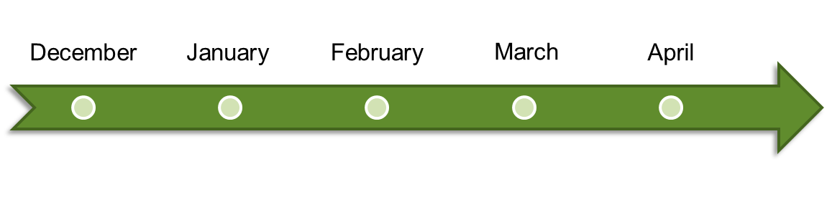


Architecture Plan
Management
Architecture
Interoperability
Architecture
Iterative Development
FHIM
Iterative Development

Slide 8
Management Architecture

Slide 9






Management Architecture Plan
1. Agree on relevant data set for Management Architecture
2. Collect and validate data on FHA projects
3. Relate FHA projects to federal initiatives
4. Enhance FHA repository and write reports
5. Create Management Architecture document

Slide 10
Management Architecture – In Progress
Deliverables - completed by the end of February 2012
  Document(s) summarizing FHA assets, projects, uses and relationships
  FHA repository to reflect relevant Management Architecture information
  FHA repository reports summarizing core Management Architecture information
Benefits
  Identifies FHA projects that support the development of Interoperability Architecture
  Relates FHA to national healthcare initiatives and strategic agency priorities
  Provides summary view of the collective set of FHA initiatives
  Facilitates FHA strategic planning

Slide 11
Interoperability Architecture

Slide 12
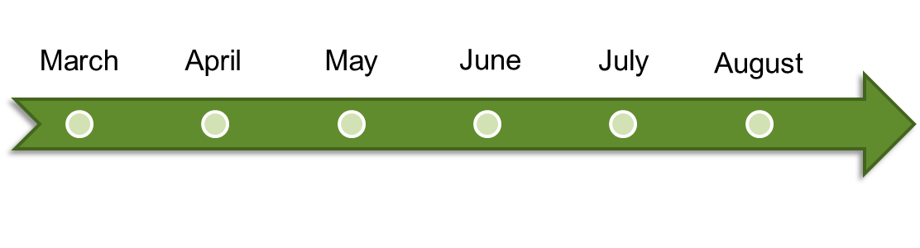






Interoperability Architecture Plan
ITERATION 1
1.1 AS-IS Architecture
1.2 TO-BE Architecture
1.3 Roadmap
ITERATION 2
2.1 AS-IS Architecture
2.2 TO-BE Architecture
2.3 Roadmap
ADDITIONAL ITERATIONS

Slide 13
Interoperability Architecture Iterations
Document architectural views
  Business Architecture – business processes supported
  Information Architecture – data sets exchanged and applicable standards
  Systems architecture – source and target systems, and applicable interfaces
Capture FHIM contents
  Harmonized UML model of the FHIM information domain(s) modeled
  Spreadsheet of FHIM information concepts for the information domain(s) modeled
  Spreadsheet mapping existing standards to the FHIM information domain(s) modeled
Use FHA repository to capture artifacts
  relevant exchanges and information about them
  reports summarizing relevant information about exchanges

Slide 14






Example of Exchange Analysis
Federal
Other – state, local,
commercial
CMS
CDC
VA
Non -
Federal
DHS
DoD
Business Architecture – business use cases, processes, requirements supported
Information Architecture – information, terminologies, value sets exchanged and applicable standards (FHIM focus area)
Systems Architecture – source and target systems, information exchange standards
Paper-based exchanges or standards such as HL7 v2
Current exchange
Supported by a variety of models and tools
Primary
Focus
Standards compliant, XML-based
Future exchange
messages and documents with common transport

Slide 15
Interoperability Architecture – Current Focus
FHIM Integration
  Finish modeling a core set of information domains (approximately 15 information domains)
  Model terminologies/value sets to support the core set of information domains
  Fully integrate the models (FHIM and associated terminologies/value sets) with the Model Driven Health Tools (MDHT)
  From the models and MDHT, generate information exchange implementation standards that support XML-based exchanges of documents and messages
  Leverage the models and MDHT to assist partners with implementing the information exchange implementation standards
Establishing infrastructure
  Instantiated the FHA repository and populated it with available high level federal health IT information
  Developed reports using FHA repository data
  Coordinating with related initiatives, such as NIEM and S&I Framework, to leverage their work for architecture development

Slide 16
Interoperability Architecture
Benefits
  Advances standards-based information exchange by producing a harmonized set of information, terminologies and value sets
  Provides a harmonized information model that can be leveraged by federal partners to create internal databases that are consistent with information standards
  Provides integrated, model-based tools to assist federal partners in developing instance implementations of information exchange standards

Slide 17








Architecture Process
Management
Architecture
Governance
Interoperability
Architecture

Slide 18
FHA GOVERNANCE

Slide 19

FHA Governance Structure
A new governance structure being put into place that would:
  Align with original FHA governance model
  Create more strategic focus and direction
  Streamline board structure
  Continue to provide venue for Federal agency participation and input
  Enable funding partners to more
  effectively provide programmatic
  guidance and direction

Slide 20


Federal Health Architecture (FHA) –
Proposed Governance Model
FHA Governing Board
Strategic Direction and Oversight
FHA Managing Board
FHA Advisory Board
Planning and Management
Architecture & Modeling Workgroup
Collaborative cross-agency work on specific areas of FHA focus
Data Exchange & Interoperability Workgroup
Communication & Coordination
Workgroup

Slide 21
FHA Governance – Technical Workgroups
Build out Federal Health Interoperability Architecture in priority areas
Facilitate collaboration across Federal health partners in aligning health architectures
Align the Federal Health Information Model with the S&I Framework
Align with Health Domain and NEIM
Architecture & Modeling
Develop overarching strategy and plan for data exchange and interoperability initiatives across partners and with private partners
Initiate collaborative efforts in priority areas
Align data exchange and interoperability initiatives with the S&I framework
Develop transition plan for moving CONNECT to open source, distributed development model
Data Exchange & Interoperability
Federal health investment planning and reporting
Interagency agreements
Communications and outreach on Federal health initiatives
Communication & Coordination
*Standing or ad-hoc Workgroups, as identified, recommended by Managing Board and approved by Governing Board

Slide 22
DISCUSSION ON CURRENT WORK FOCUS

Slide 23
DISCUSSION ON FHA PARTNER PRIORITIES

Slide 24
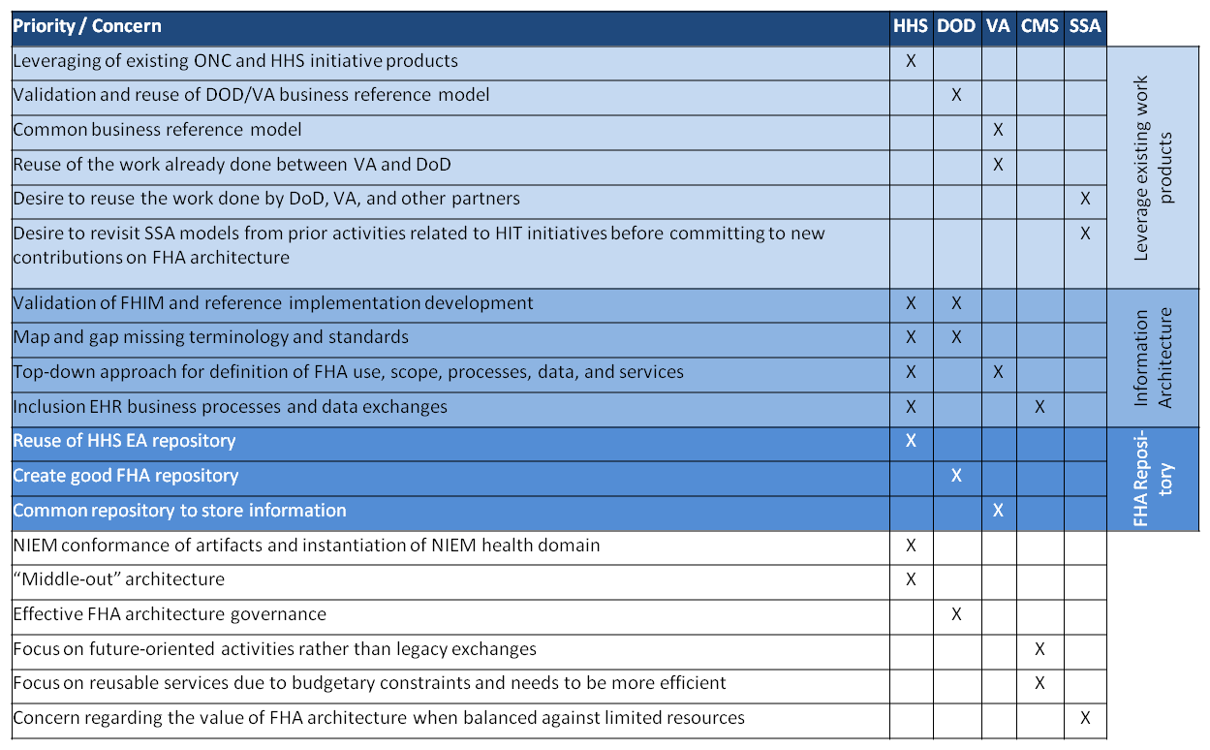
Partner Priorities Identified to Date

Slide 25
Next Steps
Continue to gather and refine partner priorities
Continue work on Management Architecture
Plan for first iteration of Interoperability Architecture
Operationalize FHA governance

Slide 26
APPENDICES

Slide 27
FHIM Work
Information Domains Already Modeled
  Person
  Security and Privacy
  Eligibility
  Enrollment
  Coordination of Benefits
  Behavioral Health Assessments
  Problems
  Allergies
  Orders (General)
Information Domains Currently Being Modeled
  Lab
  Medications/Pharmacy
  Query Health information (S&I initiative)
  Public Health Reporting (S&I initiative)

Slide 28
FHIM Work To Date
FHIM Work
Ongoing terminology modeling/value set definition work
Ongoing work to integrate the IM Project/FHIM into the S&I Framework
  Use case requirements
  Harmonization of core concepts
  Implementation specifications
Ongoing work to support S&I Framework Initiatives
  Lab
  Transition of Care
  Query Health
  Public Health Reporting
Two prototypes to produce NIEM implementations using FHIM and MDHT

